Slide 1
Macroeconomics マクロ経済学
Chap.16 Simultaneous Equilibrium in Product and Money Markets and Monetary & Fiscal Policies
第16章 財市場と貨幣市場の同時均衡と金融・財政政策

Slide 2
Partial equilibrium analysis advocated by Marshall= To analyze how equilibrium national income and equilibrium price level are determined at the equilibrium of product (goods) market, and how equilibrium money and equilibrium interest rate are determined at the equilibrium of money market, respectively.
Simultaneous equilibrium analysis advocated by Hicks=To analyze how equilibrium in the goods market is determined by I(investment)=S(savings) curve, and how equilibrium in the money market is determined by L=M curve, and how simultaneous equilibrium in both markets is achieved at the intersection of IS curve and LM curve.
To analyze effects of monetary and fiscal policies in three cases of full employment, under-employment and depression.
General equilibrium analysis advocated by Walras= To analyze how general equilibrium is achieved in ​​all macro market interrelationships such as goods, labor, securities and money markets at the same time. ⇒ simultaneous equilibrium analysis plays a role of a bridge to it.
部分均衡分析（partial equilibrium analysis）マーシャル＝生産物市場（財市場）の均衡により均衡国民所得や均衡物価水準がどのように決定されるかを分析、貨幣市場の均衡により均衡貨幣量や均衡利子率がどのように決まるかを分析
同時均衡分析（simultaneous equilibrium analysis）＝生産物市場の均衡は投資I＝貯蓄SによりIS曲線、貨幣市場の均衡は貨幣需要L＝貨幣供給MによりLM曲線。よって両市場の同時均衡はIS曲線とLM曲線の交点で達成。
⇒ヒックスにより考案され、IS＝LM分析（IS＝LM analysis）
金融政策や財政政策の効果を完全雇用、不況、不完全雇用の3つの経済状態に分けて究明。
一般均衡分析（general equilibrium analysis）＝生産物市場や貨幣市場だけでなく債券市場や労働市場を含め、すべてのマクロ市場の相互連関の中で均衡値を得るかの分析、＝同時均衡分析はそれへの橋渡し

Slide 3
１．Market Economy and Economic Policy 市場経済と経済政策
Perfectly competitive market ⇒stably converging to equilibrium, full employment in the sense that there is no voluntary unemployment
⇒ In the classical economy of full employment, the government provides policies to maintain market order to guarantee perfect competition, public finance provides public goods such as national defense, justice, schools, roads, harbors, etc. , monetary policy aims to maintain the stability of internal value of currency= prices and the stability of external value of currency = exchange rate, the government should not impair private vitality that carries private free economic activities but make up for market failures. ... ... Cheap government, Small government, Liberalism state, Night watchman nation (Nachtwächterstaat)
First theory of economic policy = Pigou’s “The Economics of Welfare" in 1920
He classified economic policy objectives into three ⇒ economic growth, economic stability, economic equality = Policy objectives of welfare economics = a standard policy objective of modern theory of economic policy.
完全競争市場⇒均衡へと安定的に収束、自発的失業がないという意味で完全雇用
⇒古典派的な完全雇用の経済では、政府は完全競争を保証する市場秩序を維持する政策、財政では国防や司法、学校、道路、港湾などの公共財を提供し、金融では通貨の対内的価値＝物価の安定と、通貨の対外的な価値＝為替相場の安定を維持する政策、政府は民間の自由な経済活動を担う活力＝民活を損なうべきではなく、市場の失敗（market failures）を補うだけ、……安価な政府（cheap government）、小さな政府（small government）、自由主義国家（liberalism state）、夜警国家（Nachtwächterstaat）
最初に経済政策の理論＝ピグウ、1920年の『厚生経済学』、経済政策の目標を3つに分類
⇒経済成長、経済安定、経済平等、＝厚生経済学の政策目標（policy objectives of welfare economics）は、現代経済政策論の標準的な政策目標。

Slide 4
１B．Market Economy and Economic Policy 市場経済と経済政策
Serious long-term great depression in the 1930s ⇒ Monopoly dominates over competition, price mechanism is rigid, cases where stability conditions are not satisfied, full employment is also not achieved
⇒ antitrust law suppresses monopolistic control of prices by large companies and labor unions, policy to promote competition through restoring flexible adjustment of price mechanism, government’s aggressive intervene in the economy by monetary and fiscal policies= Keynesian discretionary policy ⇒ presence of big government ⇒ enlargement of government since the Oil Shock in 1973
⇒ Since the 1980s, policies were conducted to suppress the budget deficit and the enlargement of government, to revive private economic vitality by deregulation, and policy theory to revive economic growth⇒ New liberalism whose leader was Friedman
Correct government failures by big government, aim for a small government again Controversy between Keynesianism and New monetarism (new liberalism)
1930年代に深刻で長期的な世界大恐慌⇒競争より独占が優勢、価格機構は硬直的、安定条件も満たされないケース、完全雇用も達成されない⇒独占禁止法などにより大企業や労働組合の独占的な価格支配を抑制、価格機構の伸縮的調整作用を回復させる競争促進政策、金融政策や財政政策などで政府が積極的に経済介入⇒ケインジアンの裁量政策（Keynesian discretionary policy）⇒大きな政府（big government）が登場
⇒1973年の石油危機を契機に政府の肥大化（enlargement of government）
⇒1980年代からは財政赤字の累積化や政府の肥大化を抑制、規制緩和によって民間の自由な経済活力を蘇生、経済成長を復活させようとする政策論
⇒フリードマンを総帥とする新自由主義（new liberalism）
大きな政府による政府の失敗（government failures）を是正、小さな政府を再び目指す
ケインジアニズム対ニューマネタリズム（新自由主義）の論争

Slide 5
２．Equilibrium in Goods Market and IS Curve 生産物市場の均衡とIS曲線
Equilibrium of supply and demand in product market = aggregate supply Y equals aggregate demand, which is the sum of consumption and investment, Y＝C＋I
Income Y is the sum of consumption C and the portion that was not consumed, that is, savings S, Y＝C＋S
Substituting into the above equation, the equilibrium condition is S＝I .
The balance of savings S and investment I is equivalent to product market equilibrium.
According to Keynes‘ absolute income hypothesis, savings S is an increasing function of national income Y, S＝S(Y)＝－a＋(1－c)Y Saving curve in Figure 16 - 1 (2).
Investment I is a decreasing function of interest rate i according to the theory of Keynes' marginal efficiency, I＝I(i) Investment curve in Figure 16-1(1).
生産物市場の需給均衡＝総供給Yが消費と投資の合計からなる総需要に等しい,Y＝C＋I
所得Yは消費Cと消費されなかった部分すなわち貯蓄Sの合計、 Y＝C＋S
上式に代入すると、均衡条件式は、 S＝I
貯蓄Sと投資Iが均衡していることが、生産物市場均衡と同値
ケインズの絶対所得仮説によれば、貯蓄Sは国民所得Yの増加関数、
S＝S(Y)＝－a＋(1－c)Y 16-1図(2)の貯蓄曲線。
投資Iはケインズの限界効率の理論によれば利子率iの減少関数、I＝I(i)、
16-1図(1)の投資曲線

Slide 6
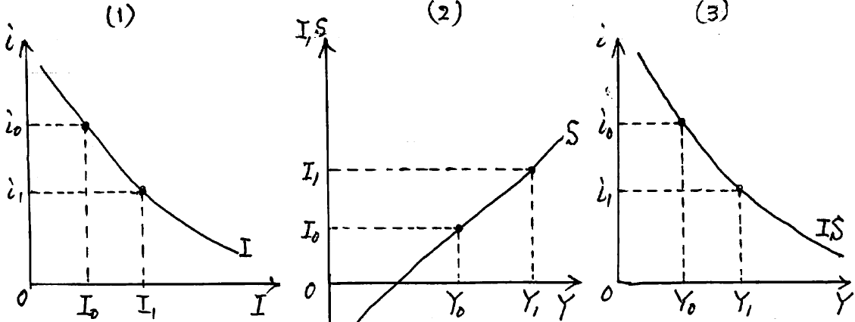
２B．Equilibrium in Goods Market and IS Curve 生産物市場の均衡とIS曲線
When the interest rate is i₀, the investment corresponding to it from Figure 1 (1) is I₀, when the interest rate drops to i₁ , investment projects with a lower marginal efficiency are also adopted, so the investment is I₁. In figure 16 - 1 (2), national income when small investment I₀ and the savings S equilibrate is Y₀, national income when the increased investment I₁ and the savings S equilibrate is Y₁. ⇒ Balance of investment I = savings S
Hicks called this IS curve, that means product market equilibrium, Figure 16-1,
利子率がi₀の時、16-1図(1)からそれに対応する投資はI₀、利子率がi₁に下がると、より低い限界効率の投資プロジェクトも採用されるので、投資はI₁,16-1図(2)で、少ない投資I₀と
貯蓄Sが均衡するときの国民所得はY₀、増えた投資I₁と貯蓄Sが均衡するときの国民所得はY₁、⇒投資I＝貯蓄Sの均衡
ヒックスはこれをIS曲線（IS curve）, 生産物市場は均衡、16-1図、
いまの説明を組み合わせた
図が16-2図、第1象限にIS
曲線、第2象限に投資曲線I、
第3象限に投資Iと貯蓄Sの
均等線

Slide 7
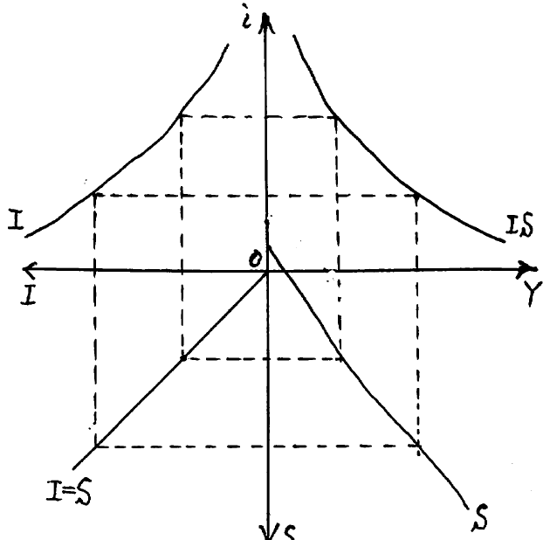
２C．Equilibrium in Goods Market and IS Curve 生産物市場の均衡とIS曲線
A diagram combining the explanations here is Figure 16-2, the investment curve I in the second quadrant, the curve in the third quadrant shows equality of I and S, the savings curve in the fourth quadrant. ⇒ the IS curve is derived in the first quadrant,
いまの説明を組み合わせた図が16-2図、第2象限に投資曲線I、第3象限に投資I＝貯蓄Sの均等式、第4象限に貯蓄曲線S、⇒第1象限にIS曲線が導かれる
16-2図

Slide 8
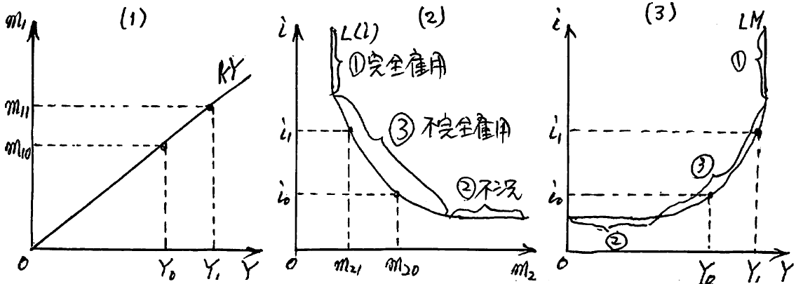
３．Equilibrium in Money Market and LM Curve 貨幣市場の均衡とLM曲線
Cambridge quantity theory of cash balance is based on transactions and precautionary motives and Keyes’s theory of liquidity preference is based on speculative motive. The two leads to money demand function, M^{D}／P＝kY＋L(i) ＝m₁＋m₂ Money supply M^{S} is M^{S}／P＝M／P
∴ Equilibrium of supply and demand in the money market is, M／P＝kY＋L(i) ＝m₁＋m₂
The money demand of the quantity theory of cash balance is m₁＝kY , shown in Figure 16-3 (1).
The money demand of the theory of liquidity preference is m₂＝L(i) , shown in Figure 16-3 (2)
When the interest rate is i₀, money demand based on speculative motive is m₂₀ in Figure 16-3 (2).
Money demand based on transactions motive is m₁₀ in Figure 16-3 (1). The corresponding national income is Y₀.
取引動機・予備的動機に基づくケンブリッジの現金残高数量説と投機的動機に基づく流動性選好説により、貨幣需要M^{D}は M^{D}／P＝kY＋L(i) ＝m₁＋m₂, 貨幣供給M^{S}は、M^{S}／P＝M／P
∴貨幣市場の需給均衡
M／P＝kY＋L(i) ＝m₁＋m₂
現金残高数量説の貨幣需要m₁
＝kY
流動性選好説の貨幣需要m₂＝L(i)
利子率がi₀の時、16-3図(2)におい
て投機的動機の貨幣需要はm₂₀、
16-3図(1)では取引動機の貨幣
需要はm₁₀、対応する国民所得はY₀

Slide 9
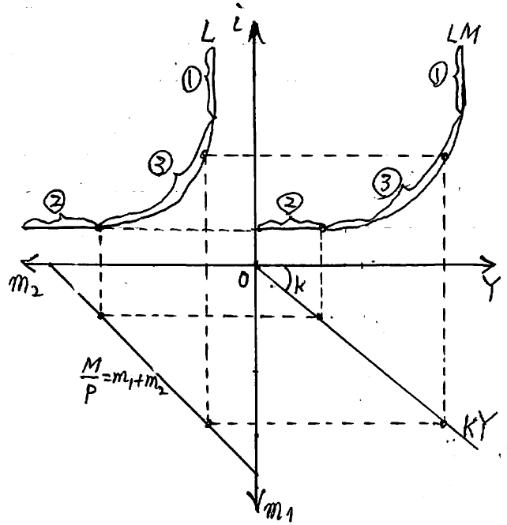
３B．Equilibrium in Money Market and LM Curve 貨幣市場の均衡とLM曲線
When the interest rate rises to i₁, bond demand increases, so money demand is m₂₁ in Figure16-3 (2) , that amount is activated for transactions.
In Figure 16-3 (1), the money demand of the corresponding transactions motive is m₁₁, the corresponding national income is Y₁ ⇒ As shown in Figure 16-3 (3), the combinations of low interest rate i₀ and low income Y₀, or high interest rate i₁ and high national income Y₁ achieves the equilibrium in the money market ⇒ Hicks called it LM curve.
A diagram combining the above explanation now is shown in Figure 16-4, the liquidity preference curve L in the second quadrant, the equality formula of money supply and demand M/P＝m₁＋m₂ in the third quadrant, the money demand based on transactions motive in the fourth quadrant, a combination of low interest rate i₀ and low national income Y₀, high interest rate i₁ and high national income Y ⇒ LM curve is derived in the first quadrant.
利子率がi₁に上がると、債券需要が増えるので、16-3図(2)において
貨幣需要はm₂₁、その分が取引用に活動化、
16-3図(1)では対応する取引動機の貨幣需要はm₁₁、対応する国民
所得もY₁ ⇒すなわち16-3図(3)のように低い利子率i₀と低い国民
所得Y₀、高い利子率i₁と高い国民所得Y₁という組み合わせの時に、
貨幣市場の均衡⇒ヒックスはこれをLM曲線（LM curve）
いまの説明を組み合わせた図が16-4図、第2象限に流動性選好曲線
L、第3象限に貨幣需給の均等式M/P＝m₁＋m₂、第4象限に取引動
機の貨幣需要曲線、低い利子率i₀と低い国民所得Y₀、高い利子率i₁と
高い国民所得Y₁という組み合わせ、 ⇒第1象限にLM曲線が導かれる
16-4図

Slide 10
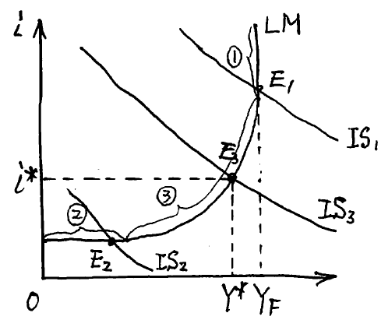
４．Simultaneous Equilibrium in Goods and Money Markets 財市場と貨幣市場の同時均衡
The equilibrium condition formula are IS curve in the product market and LM curve in the money market. Simultaneous equations are I(i)＝S(Y), M/P＝kY＋L(i) to determine two unknowns Y and i without excess or deficiency. Equilibrium national income Y* and equilibrium interest rate i* are determined by the simultaneous equilibrium.
⇒ In Figure 16-5, the intersection point E of the IS curve and the LM curve is the simultaneous equilibrium. Fig. 16-5
生産物市場の均衡条件式IS曲線と貨幣市場の均衡条件式LM曲線とを連立、 I(i)＝S(Y), M/P＝kY＋L(i) から、2つの未知数Yとiとを過不足なく決定。同時均衡により均衡国民所得Y*と均衡利子率i*とを決定。
⇒16-5図でIS曲線とLM曲線の交点Eが
同時均衡（simultaneous equilibrium）

Slide 11
４B．Simultaneous Equilibrium in Goods and Money Markets財市場と貨幣市場の同時均衡
When ①full employment part of the LM curve intersects the IS₁ curve, point E₁ is a full employment equilibrium Y_{F}
When ② depression part of the LM curve intersects the IS₂ curve, , point E₂ is an under-employment equilibrium. When ③ under-employment part of the LM curve intersects the IS₃ curve, point E₃ is an under-employment equilibrium.
Hicks formulated it as "IS = LM analysis" in his “Mr. Keynes and the classical school" in 1937,
Hansen evolved this to more elaborate analysis.⇒ Hicks = Hansen synthesis
However, it is not a general equilibrium representing the equilibrium in all markets Fig. 16-5
LM曲線の①完全雇用の部分とIS₁曲線が交わる場合はE₁は完全雇用均衡Y_{F}
LM曲線の②不況の部分とIS₂曲線が交わる場合、LM曲線の③不完全雇用の部分とIS₃曲線が交わる場合は、E₂とE₃は不完全雇用均衡
ヒックスは1937年の『ケインズ氏と古典派』でIS＝
LM分析として定式化、
ハンセンはこれを一層精緻な分析へと進化
⇒ヒックス＝ハンセン総合（Hicks=Hansen synthesis）
ただしすべての市場の均衡を表す一般均衡ではない
16-5図

Slide 12
５．Monetary and Fiscal Policies 金融政策と財政政策
Typical policies which work on product market and money market, shift IS curves and LM curves, influence equilibrium national income and equilibrium interest rate, achieve policy objectives such as price stability, economic stability, employment stability, etc. ⇒ Monetary policy and fiscal policy.
= Economic stabilizing policy (policies based on fine tuning of economic fluctuations)
Monetary policy = Policy which the central bank and the government (Ministry of Finance), as policy subjects, influence the money supply and interest rate using policy instruments such as official discount rate operation, open market operation, reserve ratio operation, exchange rate policy, etc. and achieve policy objectives such as stabilization of prices, stabilization of exchange rates and stabilization of business cycle, etc.. It also contributes to government policy objectives such as economic growth and full employment through them.
生産物市場や貨幣市場に働きかけて、IS曲線やLM曲線をシフトさせ、均衡国民所得や均衡利子率に影響を及ぼして、物価の安定、景気の安定、雇用の安定などの政策目標を達成する代表的な政策⇒金融政策と財政政策。
＝経済変動の微調整（ファインチューニング）による政策を経済安定化政策（economic stabilizing policy）
金融政策（monetary policy）＝中央銀行や財務省などの政策主体が、公定歩合操作、公開市場操作、準備率操作、為替政策などの政策手段を用いて、マネーサプライや利子率に影響し、物価の安定や為替相場の安定、景気の安定などの政策目標を達成する政策。それらを通じて経済成長や完全雇用など政府の政策目標にも貢献。

Slide 13
５B．Monetary and Fiscal Policies 金融政策と財政政策
Quantitative monetary policy = policies that quantitatively controls the amount of money and the rate of interest and exerts an effect on policy objectives Easy monetary policy＝ increases the money supply by lowering official discount rate, selling operation of securities, raising reserve ratio, etc., to shift the LM curve to the right Tight monetary policy＝ reduces the money supply by raising official discount rate, buying operation of securities, lowering reserve ratio, etc., to shift the LM curve to the left
Qualitative monetary policy ＝policies that maintain and improve credit order qualitatively through maintaining and improving institutions such as financial institutions and banking institutions
量的金融政策（quantitative monetary policy）=貨幣量や利子率などを量的に制御して政策目標に効果を及ぼす政策
金融緩和政策（easy monetary policy）は公定歩合引き下げ、売りオペレーション、準備率引き上げなどでマネーサプライを増やすので、LM曲線を右方シフト
金融引き締め政策（tight monetary policy）は公定歩合引き上げ、買いオペレーション、準備率引き下げなどでマネーサプライを減らし、LM曲線を左方シフト
質的金融政策（qualitative monetary policy ）金融制度や銀行制度などの制度を維持・改善することを通じて信用秩序を維持・改善する政策

Slide 14
５C．Monetary and Fiscal Policies 金融政策と財政政策
Fiscal policy = Policy that the government, as a policy subject, works directly on aggregate demand = aggregate expenditure, using policy measures such as increasing or decreasing fiscal expenditure, changing tax rate, etc., to achieve policy objectives such as economic stability and employment stability, etc..
Positive fiscal policy＝increases fiscal expenditure and therefore government consumption and investment expenditures to increase aggregate demand, and conducts tax cuts to increase private expenditures through increasing private disposable income. These have an expansionary effect to shift the IS curve to the right.
Tight fiscal policy = decreases fiscal expenditure and therefore government consumption and investment expenditures to decrease aggregate demand, and conducts tax increase to decrease private expenditures through decreasing private disposable income. These have a contractive effect to shift the IS curve to the left.
Balanced budget principle ⇒In principle, according to the Japanese Finance Law, expenditure should be covered by tax revenue. But issuance of public bonds based on special law and construction bonds are approved as a source of aggressive fiscal policy. the issuance of public bonds and construction bonds.
財政政策（fiscal policy）＝政策主体である政府が、財政支出の増減、税率の変更などの政策手段を用いて、総需要＝総支出に直接働きかけ、景気の安定や雇用の安定などの政策目標を追求する政策
積極財政政策（positive fiscal policy）＝財政支出を増やせば政府の消費支出や投資支出が増えるので総需要を増やし、減税を行えば可処分所得の増大から民間支出を増やして、IS曲線を右方シフトさせる拡張効果。
財政引き締め政策（tight fiscal policy）＝財政支出を減らせば総需要を減らし、増税を行えば可処分所得の減少から民間支出を減らし、IS曲線を左方シフトさせる収縮効果。
均衡予算主義（balanced budget principle）を原則⇒日本の財政法では歳出は租税収入で賄う原則。しかし積極財政政策の財源としては、特例法による公債や建設国債の発行。

Slide 15
５D．Monetary and Fiscal Policies 金融政策と財政政策
Public debt and borrowing are allowed as a source of public works, investment funds and loan.
For the construction of public capital, construction bond has been admitted which is redeemed for 60 years.
⇒ It is justified that public works such as road construction is financed by issuing public bonds in depression and that reconstruction projects of great earthquake are financed by public bonds and construction bonds.
Public works and reconstruction projects will benefit future generations from 60 to 100 years ahead, so their costs should be borne evenly by each generation over the long run.
⇒ Conversely, financing public works projects and reconstruction projects which have long-run effects with short-term government bonds or tax increases incorrectly places an excessive burden on present working generations, so mistakes, also violate the purpose of fiscal law.
⇒ It is a mistake and violates the Fiscal Law to pay annual ordinary consumption expenditure by issuing public bonds, because it imposes an undue burden on future generations.
公共事業費、出資金及び貸付金の財源については公債や借入金を認める。
公共資本の建設には60年償還の建設国債を認めている。
⇒不況時に道路建設などの公共事業を公債発行によって行うことも、大震災の復興事業を公債や建設国債によって賄うことも正当化。
公共事業や復興事業は60年から100年に及ぶ将来世代も恩恵を被るので、長期にわたって各世代で均等に負担するべきもの。
⇒逆に長期的効果を持つ公共事業や復興事業を短期の公債や増税で賄うことは、現役世代に不当に過重な負担を掛けるので間違い、財政法の趣旨にも違反。
⇒毎年の経常的な消費的支出を公債発行で賄うことは、将来世代に不当に過重な負担を掛けるので間違い、財政法に違反。

Slide 16
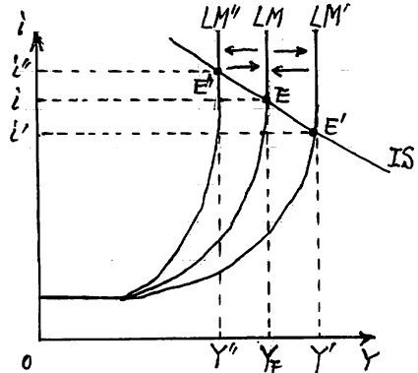
６．Full employment and Monetary Policy完全雇用と金融政策
Full employment ⇒ Macro production function Y＝F(N, K), labor N is full employment, capital K is fully utilized
⇒ Full employment national income Y_{F}, real national income will not increase further. LM curve is vertical, money demand does not respond to interest rate i, interest inelastic. M/P＝kY＋L(i)＝kY L’(i)＝0
⇒ L(i) is abbreviated, classical school quantity theory of money , Cambridge quantity theory of cash balance are effective.
Easy monetary policy Easy monetary policy increases the money supply amount M ⇒ LM curve shifts right to LM‘ in the figure 16-6, the equilibrium point also shifts from point E to point E'. The equilibrium interest rate declined from i to i', the equilibrium national income increased from Y_{F} to Y'. Since Y‘ exceeds Y_{F} of full employment national income, the price P rises only by the increase in nominal income. Real income is not changed by Y_{F}, real interest rate is also unchanged at i. ... The primary effect explained by Keynesian (first-round effect), quantity theory of money is reasonable
完全雇用⇒マクロ生産関数Y＝F(N, K)で労働Nは完全雇用、資本Kは完全利用⇒完全雇用国民所得Y_{F}、実質国民所得はこれ以上に増えない。LM曲線は垂直、貨幣需要は利子率iに対して反応をしない、利子非弾力的。 M/P＝kY＋L(i)＝kY L’(i)＝0
⇒L(i)は省略、古典派の貨幣数量説、ケンブリッジの現金残高
数量説が有効
（１）金融緩和政策
金融緩和で貨幣供給量Mを増加⇒16-6図でLM曲線はLM’へ
と右方シフト、
均衡点もE点からE’点へとシフト。均衡利子率はiからi’へと低下、
均衡国民所得はY_{F}からY’へと増。Y’は完全雇用国民所得Y_{F}を超
えているので、名目所得の増加だけ、物価Pが上昇。実質所得は
Y_{F}で変わらず、実質利子率もIで不変。 16-6図
…ケインジアンが説明する一次的効果（first-round effect）
貨幣数量説が妥当

Slide 17
６B．Full employment and Monetary Policy 完全雇用と金融政策
New quantity theory of money advocated by Friedman (New monetarism) ⇒ Increase in price P causes Pigouvian effect through reduction of real asset value, resulting in the second-round effect or ultimate effect
Pigouvian effect = real balance effect, wealth effect
Increase in price P ⇒ decreases real money supply M/P ⇒ effect of returning LM curve from LM'⇒, return to full employment national income Y_{F}, the equilibrium interest rate also returns from i' to i and recover the equilibrium point E.
∴ Increase in nominal income (Y’－Y_{F}) turns into inflation gap, prices rise,
⇒ In full employment, money is neutral to the real economy, monetary policy has no effect. Increase in the amount of money simply raises the price P.
フリードマンなどの新貨幣数量説（ニューマネタリズム）⇒物価Pの上昇が実質資産価値の減少を通じてピグウ効果（Pigouvian effect）を生じ二次的効果（second-round effect）ないし究極的効果（ultimate effect）
ピグウ効果＝実質残高効果（real balance effect）、資産効果（wealth effect）
物価Pの上昇⇒実質貨幣供給量M/Pを減少⇒LM曲線をLM’から元へ戻す効果⇒、完全雇用国民所得Y_{F}まで戻し、均衡利子率もi’からiに戻り、均衡点Eを回復
∴名目所得の増加分(Y’－Y_{F})はインフレギャップ、物価上昇に転化、
⇒完全雇用では、貨幣は実体経済に対して中立、金融政策は効果を持たない。
貨幣量の増加は単に物価Pを上昇。

Slide 18
６C．Full employment and Monetary Policy 完全雇用と金融政策
(2) Tight monetary policy
Tight monetary policy in full employment ⇒ deceases the money supply M, shifts the LM curve left to LM“ in Figure of 16-6; raises interest rate i to i”, decreases equilibrium income Y to Y”,⇒ under-employment equilibrium E”. Price P is rigid in under-employment.⇒ Tight monetary policy has an effect in the neighborhood of full employment …Keynesian first-round effect.
New monetarist ⇒ recession lowers the price P, the real balance of money increases, Pigouvian effect shifts the LM curve right to LM”.⇒the second round effect or ultimate effect restores real income Y/P, real rate of interest i/P and recovers full employment equilibrium E ⇒A decease in the money supply lowers the price P only, and does not influence real economy⇒money is neutral to real economy, and monetary policy has no effect on real economy.
（2）金融引き締め政策
完全雇用で金融引き締め⇒貨幣供給量Mを減少、16-6図でLM曲線はLM”へと左方シフト、均衡利子率はiからi”へ上昇、均衡所得はYからY”へと減、⇒不完全雇用均衡E”。物価Pは完全雇用未満の状態では下方硬直性。⇒金融引き締め政策は、完全雇用近傍でも効果を持つ……ケインジアンの一次的効果
ニューマネタリスト⇒景気が後退すると物価Pが下落、実質貨幣残高M/Pは増加、ピグウ効果でLM曲線はLM”からLMへと右方シフト⇒二次的効果、究極的効果では実質所得も実質利子率も元に戻り、完全雇用均衡E点が回復。⇒貨幣量Mの減少は物価Pのみを下落、実体経済には影響しない⇒貨幣は中立、金融政策は効果を持たない。

Slide 19
６D．Full employment and Monetary Policy 完全雇用と金融政策
Ultra Keynesian ⇒approves perfect upward flexibility of the price P in full employment and perfect downward rigidity of the price P in under-employment.
Ultra monetarist ⇒ approves perfect upward and downward flexibility of the price P in both full employment and under-employment.
⇒ In the actual economy, 100% of elasticity of prices P is not complete, and 100% of downward rigidity of prices P is not complete, as well.
⇒ It is not a theory but positive analysis that determines truth.
ウルトラ・ケインジアン（ultra Keynesian）⇒完全雇用以上の状態では物価Pの完全な上方伸縮性を認め、完全雇用未満の状態では物価Pの完全な下方硬直性
ウルトラ・マネタリスト（ultra monetarist）⇒完全雇用でも不完全雇用でも上方にも下方にも物価Pの完全な伸縮性を認める。
⇒現実経済では物価の伸縮性が100%完全であることはなく、物価Pの下方硬直性が100％完全であることもない
⇒真実は、理論ではなく実証分析が決める

Slide 20
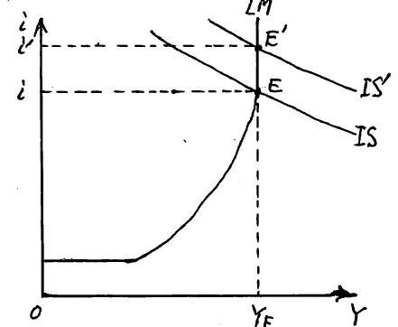
７．Full Employment and Fiscal Policy 完全雇用と財政政策
(1) Active fiscal policy
State of full employment ⇒Active fiscal policy increases aggregate demand by expanding fiscal expenditure G or reducing tax T⇒ IS curve shifts right from IS to IS ‘⇒ Real income never exceeds Y_{F}. ⇒ Equilibrium income remains unchanged at Y_{F} and the equilibrium interest rate shifts upward from i to i’⇒ Private investment I is decreased by ΔI ⇒ Offset against ΔG of expansion of fiscal expenditure G ∴ National income remains unchanged at Y_{F} Y_{F}＋ΔG－ΔI＝Y_{F} ... Increase in fiscal expenditure ΔG crowd out private investment by ΔI ＝crowding out effect ... The classical theory is appropriate. Original function of public finance is resource allocation of providing public goods Figure 16-7
（１）積極財政政策
完全雇用の状態⇒財政支出Gの拡大か減税で総需要を増やす
積極財政政策⇒IS曲線はISからIS’へと右方シフト⇒実質所得
がY_{F}を上回ることはない⇒均衡所得はY_{F}のまま変わらず、均衡
利子利率がiからi’へと上方へシフト⇒民間投資IをΔIだけ減少
⇒財政支出Gの拡大分ΔGと相殺、∴国民所得はY_{F}のまま不変
Y_{F}＋ΔG－ΔI＝Y_{F}
…財政支出の増加分ΔGが民間投資をΔIだけ締め出す（crowd
out）クラウディング・アウト効果（crowding out effect）
…古典派の理論が妥当。公共財の提供という財政本来の資源
配分機能 16-7図

Slide 21
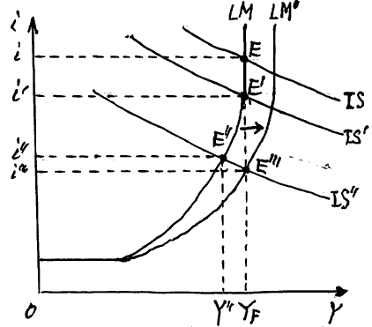
７B．Full Employment and Fiscal Policy 完全雇用と財政政策
(2) Fiscal Tightening Policy State of full employment ⇒ Fiscal tightening policy decreases aggregate demand by reducing fiscal expenditure G or raising tax T⇒ The IS curve shifts left from IS to IS‘ in Figure 16-8. Real income remains Y_{F}. ⇒ Equilibrium income remains unchanged at Y_{F} and the equilibrium interest rate shifts downward from i to i' ⇒ The decline in interest rate increases private investment I by ΔI, offsetting with the reduced portion ΔG of fiscal expenditure G Y_{F} －ΔG＋ΔI＝Y_{F} ... Decrease in fiscal expenditure ΔG clowds in private investment by ΔI = crowding in effect ... the classical theory is appropriate. Figure 16-8
（２）財政引き締め政策
完全雇用の状態⇒財政支出Gの縮小か増税で総需要を減らす財政引き締め政策⇒16-8図でIS曲線はISからIS’へと左方シフト。実質所得はY_{F}のまま。⇒均衡所得はY_{F} のまま変わらず、均衡利子利率がiからi’へと下方へシフト
⇒利子率の下落は民間投資IをΔIだけ増加、財政
支出Gの縮小分ΔGと相殺 Y_{F} －ΔG＋ΔI＝Y_{F}
…財政支出の縮小分ΔGが民間投資をΔIだけ押し入れる
（crowd in）クラウディング・イン効果（crowding in effect）…
古典派の理論が妥当 16-8図

Slide 22
７C．Full Employment and Fiscal Policy 完全雇用と財政政策
(3) Strong fiscal tightening policy
In the case of strong fiscal tightening policy⇒ it reduces aggregate demand by reducing fiscal expenditure G or increasing tax T⇒ In the figure, the IS curve shifts further left from IS‘ to IS"⇒ The equilibrium point shifts from E’ to the E “. equilibrium income decreases from Y_{F} to Y ", the equilibrium interest rate downshifts from i 'to i" ⇒ Increases private investment I by ΔI, can not offset the reduced part ΔG of government expenditure G, national income declined from Y_{F} to Y ", meaning the crowding-in effect is incomplete.
Y_{F} －ΔG＋ΔI＝Y”＜ Y_{F}... the Keynesian first round effect
New monetarist ⇒ economic recession declines prices P, increases real money balance M / P , Pigouvian effect shifts the LM curve right from LM to LM‘, monetary easing effect. ⇒ Second-round effect or ultimate effect recovers full employment income by lowering prices P and increasing real income Y_{F} , the real interest rate also falls to i''' and the equilibrium point reaches a new E''', recover full employment equilibrium.
（３）強力な財政引き締め政策
財政支出Gの縮小か増税で総需要を減らす財政引き締め政策が強力である場合⇒16-8図でIS曲線はIS’からIS”へとさらに左方シフト⇒均衡点はE’点からE”点にシフト、均衡所得はY_{F}からY”へと減少、均衡利子利率はi’からi”へ下方シフト⇒民間投資IをΔIだけ増加、財政支出Gの縮小分ΔGと相殺し切れずに、国民所得はY_{F}からY”へと減少。つまりクラウディング・イン効果は不完全 Y_{F} －ΔG＋ΔI＝Y”＜ Y_{F} …ケインジアンの一次的効果
ニューマネタリスト⇒景気が後退で物価Pが下落、実質貨幣残高M/Pは増加、ピグウ効果でLM曲線はLMからLM’へと右方シフト、金融緩和効果。⇒二次的効果・究極的効果では物価下落に伴い実質所得は増えて完全雇用国民所得Y_{F}を回復、実質利子率もi”’に下がり、均衡点も新たなE”’に到達。完全雇用均衡を回復

Slide 23
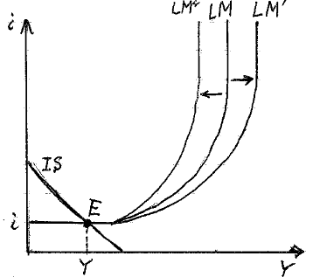
８．Depression and Monetary Policy 不況と金融政策
In the Great Depression in 1930s,⇒The interest rate i sticks to the lower limit and the interest elasticity of money demand is L‘(i) = - ∞, infinite. Even an increase in the money supply will be hoarded and will not be used as active balance = liquidity trap ＝the horizontal part of the LM curve in figure 16-9.
(1) Easy monetary policy Increases the money supply M ⇒ the LM curve shifts right to LM‘ in Figure 16-9, but in the liquidity trap the LM curve remains horizontal. Equilibrium point is also E, equilibrium income Y and equilibrium interest rate i are unchanged. There is no change in price P as well. There is no effect of easy monetary policy.
Tight monetary policy decreases the money supply M⇒ the LM curve shifts left to LM“ in Figure16-9, but in the liquidity trap the LM curve remains horizontal. Equilibrium point is also E, equilibrium income Y and equilibrium interest rate i are unchanged. There is no change in price P as well. There is no effect of tight monetary policy.
1930年代大不況（great depression）⇒利子率iは下限に張り付き、貨幣需要の利子弾力性はL’(i)＝－∞、と無限大。貨幣供給を増やしても、退蔵されて、活動残高として使われることはない＝流動性の罠（liquidity trap） 16-9図でLM曲線の水平部分
（１）金融緩和政策
金融緩和で貨幣供給量Mを増加⇒16-9図でLM曲線はLM’へ
と右方シフト、流動性の罠では、LM曲線は水平のまま。均衡点
もE点のまま、均衡所得Yも均衡利子率iも不変。物価Pにも何ら
変化なし。金融緩和政策の効果なし
（２）金融引き締め政策
金融引き締めで貨幣供給量Mを減少⇒16-9図でLM曲線はLM”
へ左方シフト、流動性の罠でLM曲線は水平のまま。均衡点もE点
のまま、均衡所得 Yも均衡利子率iも不変。物価Pも不変。金融引き
締め政策の効果なし。 16-9図 金融緩和と金融引き締め

Slide 24
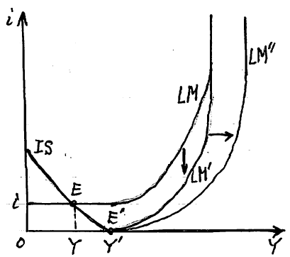
８B．Depression and Monetary Policy 不況と金融政策
(3) Zero Interest Rate Policy
Keynes ‘General Theory’ “Jonbull can not put up with 2% interest rate” Lower-limit interest rate. 2% low interest rate in Genoa in medieval times. Since 1995, the Bank of Japan has lowered the call rate of policy interest rates to near 0% from 1%, and to 0.15% from February 1999 ＝ zero interest rate policy
Zero interest rate policy to lower the federal fund rate of policy interest rate to 0 ～ 0.25% from December 2008 after the real estate bubble collapsed in 2007 in the United States。
⇒ In the figure 16-10, the LM curve shifts down to LM', the liquidity trap part is zero interest rate.⇒ The equilibrium point with the IS curve shifts from point E to point E ‘
The equilibrium interest rate is 0%, and equilibrium income is increased to Y‘ by the investment stimulus effect. One-time economic recovery effect through a downward shift of LM curve Figure 16-10, Zero interest rate policy and quantitative easy monetary policy
（３）ゼロ金利政策
ケインズ『一般理論』「ジョンブルは2%の金利に我慢できない」下限金利、中世のジェノヴァで2％の低金利。日本銀行は1995年から政策金利のコールレートを1％を切ってゼロ％台、1999年2月からは0.15％に下げてゼロ金利政策（zero interest rate policy）
アメリカでも不動産バブルが2007年に崩壊したあと2008年12月から、
政策金利のフェデラルファンドレートを0~0.25％に下げるゼロ
金利政策⇒16-10図でLM曲線はLM’へと下方シフト、流動性
の罠の部分がゼロ金利。⇒IS曲線との均衡点はE点からE’点
へとシフト、均衡利子率は0％、その投資刺激効果により均衡
所得はY’へと増加。
LM曲線の下方シフトで一回限りの景気回復効果
16-10図 ゼロ金利政策と量的金融緩和

Slide 25
８C．Depression and Monetary Policy 不況と金融政策
(4) Quantitative Easy Monetary Policy
Increase the money supply under zero interest rate ⇒ In Figure 16-10 the LM curve shifts right from LM 'to LM” and in the liquidity trap the equilibrium point remains E. The equilibrium interest rate is zero interest rate. Equilibrium national income remains Y‘ . ⇒ The Bank of Japan has increased the supply of money to commercial banks in large quantities by conducting open market operations from March 2001 until March 2006. Under the equity ratio regulation of BIS (Bank for International Settlements), commercial banks could not increase defective loans anymore ⇒ Hoard as excess reserves beyond legal reserves ⇒ current accounts at the BOJ expands rapidly from about 5 trillion yen to 35 trillion yen, to about 327 trillion yen in 2017. = Quantitative easy monetary policy under zero interest rate It has little effect as an economic recovery policy. By accumulating excessive amounts of bank reserves, it is effective as a qualitative policy that prevents bank failures due to lack of funds and avoids systemic risks such as banks going bankrupt in a chain by deposit installment etc.
（４）量的金融緩和
ゼロ金利のもとで貨幣供給を増⇒16-10図でLM曲線はLM’からLM”へと右方シフト。流動性の罠では均衡点はE’のまま。均衡利子率はゼロ金利のまま、均衡国民所得もY’のまま。
⇒日本銀行は2001年3月から2006年3月まで公開市場操作の買いオペにより市中銀行への貨幣供給を大量に増。BIS（Bank for International Settlements; 国際決済銀行）の自己資本比率規制の下で、市中銀行はこれ以上不良貸出を増やすことはできない⇒法定準備を超える過剰準備として退蔵⇒日銀当座預金（中央銀行預け金）は、5兆円ほどから35兆円、2017年現在は327兆円ほどにまで急激に膨張。
＝ゼロ金利下の量的金融緩和（quantitative easy monetary policy）
景気回復政策としては効力を殆ど持たない。銀行準備を過剰に大量に積み上げることによって、資金不足による銀行破綻を防ぎ、銀行が預金取付などで連鎖的に倒産するようなシステム・リスクを回避する質的政策としては効果がある

Slide 26
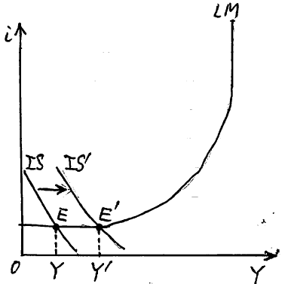
９．Depression and Fiscal Policy 不況と財政政策
(1) Active fiscal policy Active fiscal policy increases aggregate demand by expanding fiscal expenditure G or reducing tax T in liquidity trap ⇒ In Figure 16-11, the IS curve shifts right from IS to IS‘. Interest rate i is the lower limit, national income increases from Y to Y‘ by the right shift of the IS curve. Equilibrium national income increases as much as the aggregate demand increases, and investment I does not decrease while the interest rate sticks to the lower limit. ⇒ Crowding out does not occur. Price P does not rise due to excess supply.
⇒ Keynes called this aggregate demand as effective demand, the mechanism by which it determines equilibrium national income is called the principle of effective demand.
（１）積極財政政策
流動性の罠で財政支出Gの拡大か減税により総需要を増やす
積極財政政策⇒16-11図でIS曲線はISからIS’へと右方シフト。
利子率iは下限、
国民所得はYからY’へとIS曲線の右方シフトの分だけ増大。
総需要が増えた分だけ均衡国民所得が増え、利子率は下
限に張り付いている間は投資Iは減らない。⇒クラウディング
・アウトは起こらない。超過供給で物価Pも上昇しない。
⇒ケインズはこの総需要を有効需要、それが均衡国民所得
を決定する仕組みを有効需要の原理
6-11図 積極財政政策

Slide 27
９B．Depression and Fiscal Policy 不況と財政政策
In the product market, excess supply and demand shortage exist, savings S exceeds investment I, issuance of deficit national bonds will not raise interest rate i unless excess savings are resolved and remain on the lower limit ⇒ Active fiscal policy enables the economy to escape from depression by issuing deficit government bonds and expanding fiscal expenditure G.
= Theoretical ground for the justification of deficit fiscal policy The balanced budget principle of classical school that the fiscal expenditure is financed by tax (G = T) in each year is not applied to the case of depression.
⇒ Keynes did not claim that fiscal budget deficit can be admitted unlimitedly. The deficit at the time of depression should be offset by surplus at booming, equilibrium in the process of business cycle rather than every single year should be aimed at.
生産物市場は超過供給・需要不足、貯蓄Sが投資Iを超過、赤字国債を
発行しても貯蓄超過が解消されない限りは利子率iは上昇せず、下限に
張り付いたまま⇒赤字国債発行により財政支出Gを拡大する積極財政政策で不況から脱却できる
＝赤字財政政策（deficit fiscal policy）の正当性に理論的根拠
財政支出は租税収入によって毎年賄われるべきG=Tであるという古典派の単年度の均衡予算主義（balanced budget principle）は、不況においては適用除外
⇒ケインズは財政赤字を無制限に垂れ流してよいと主張したわけではない。不況時の赤字は好況時の黒字によって相殺、単年度ごとではなく景気循環のプロセスで均衡するべき

Slide 28
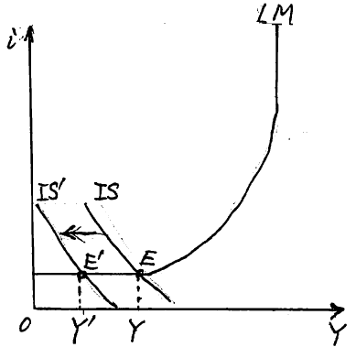
９C．Depression and Fiscal Policy 不況と財政政策
American President Roosevelt conducted New Deal policy ⇒ in 1933 Tennessee Valley Development Corporation TVA, large-scale public works projects, absorbing a large number of unemployed people, economic recovery was achieved⇒ real GDP recovered to 1929 level in 1936
German Prime Minister Hitler, in 1933 promoted the construction of high-speed motorway network of Reichs Autobahn, promotion of motorization, production of Volkswagen, large-scale public works project, absorbing mass unemployed, economic recovery was achieved.
(2) Fiscal Tightening Policy Fiscal tightening policy reduce aggregate demand by reducing fiscal expenditure G or raising tax in liquidity trap ⇒In Figure 16-12, the IS curve shifts left from IS to IS ', the interest rate i is the lower limit, and national income decreases from Y to Y' by the left shift of the IS curve
アメリカ、ルーズヴェルト大統領、ニューディール政策（New Deal）⇒1933年テネシー渓谷開発公社TVA、大規模な公共事業、大量の失業者を吸収、経済復興
⇒実質GDPは1936年には1929年水準を回復
ドイツ、ヒトラー首相、1933年に高速自動車道路網の建設や
モータリゼーションの推進、ライヒス・アウトバーンの建設やフォ
ルクスワーゲンの製造、大規模な公共事業、大量の失業者を
吸収、経済復興
（２）財政引き締め政策
流動性の罠で財政支出Gの削減か増税で総需要を減らす財
政引き締め政策⇒16-12図でIS曲線はISからIS’へと左方シフト、
利子率iは下限、国民所得はYからY’へとIS曲線の左方シフトの
分だけ減少

Slide 29
９D．Depression and Fiscal Policy 不況と財政政策
⇒ Interest rate is the lower limit, and private Investment I will not increase ⇒ Crowding in will not occur ⇒ Excess supply will deteriorate further, prices P will fall and deflation will become more serious. ∴ reduction of fiscal expenditure, consumption tax increase tax, income tax increase should be avoided during depression.
Example) The Takeshita cabinet enforced with the consumption tax at 3% in April 1989, it was at the height of the bubble, but from the following 1990 the bubble collapsed, the 13-year long-run deflationary recession, the total tax revenue reached 60 trillion yen in 1990 but it decreased to 54 trillion yen in 1997.
Example) The Hashimoto cabinet increased the consumption tax to 5% in April 1997, although the economy was in the process of recovery, from July in the same year the economy reversed, the financial depression and serious deflation, the total tax revenue fell to 42 trillion yen in 2011.
⇒利子率は下限で民間投資Iは増えない⇒クラウディング・インは起こらない⇒超過供給はさらに悪化、物価Pは下落してデフレが深刻化 ∴不況時には
財政支出削減や消費税増税、所得税増税などは、避ける必要
例）竹下内閣の1989年4月に消費税が3％で施行、バブルの絶
頂期であったが、翌1990年からはバブル崩壊、13年間にわたる
長期デフレ不況、総税収は1990年の60兆円から1997年には54
兆円に減。例）橋本内閣の1997年4月に消費税が5％に増税、
景気は回復過程にあったものの、同年7月からは景気は反転下降、
金融大不況と深刻なデフレ、総税収は2011年には42兆円まで
激減 16-12図 財政引き締め政策

Slide 30
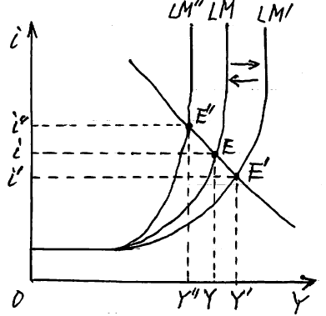
１０．Under-employment and Monetary Policy 不完全雇用と金融政策
The state of under-employment, neither full employment nor liquidity trap⇒ the LM curve is upward sloping to the right. Money demand is interest-elastic, －∞＜L’(i)＜0
(1) Easy monetary policy
Easy monetary policy increases the money supply M ⇒ As shown in figure 16-13, the LM curve shifts right to LM‘ and equilibrium point also shifts to E‘. The equilibrium interest rate declines from i to i ’, the equilibrium national income increases from Y to Y’. Price P remains unchanged until full employment. ＝The Keynesian first-round effect
完全雇用でもなく流動性の罠でもない不完全雇用の状態、
M曲線は右上がり。貨幣需要は利子弾力的、－∞＜L’(i)＜0
（１）金融緩和政策
金融緩和で貨幣供給量Mを増加⇒16-13図のようにLM曲線
はLM’へ右方シフト、均衡点もE’点へとシフト。均衡利子率は
iからi’へと低下、均衡国民所得はYからY’へと増。完全雇用
に至るまでは物価Pは不変。
…ケインジアンが説明する一次的効果 16-13図

Slide 31
１０B．Under-employment and Monetary Policy 不完全雇用と金融政策
New monetarist ⇒ The second-round effect or ultimate effect due to Pigou effect, Increase in real national income Y reduces the degree of excess supply, increases price P, decrease real money balance M / P ⇒ the LM curve shifts to the left and return before, interest rate i rises, investment I decreases, real income Y decreases. If the price P is perfectly flexible, the equilibrium point returns to E from E ‘, ⇒ the effect of easy monetary policy ultimately becomes omnipotent, the money is neutral Figure 16-13
(2) Tight Monetary policy Tight monetary policy reduces the money supply M in under-employment ⇒the LM curve shifts left to LM"in Figure 16-13, equilibrium interest rate rises from i to i", equilibrium income decreases from Y to Y “ , equilibrium point shifts from E to E ". Price P is rigid until full employment ⇒ Tight monetary policy has an effect even in under-employment ... Keynesian first-round effect
ニューマネタリスト⇒ピグウ効果による二次的効果あるいは究極的効果、
実質国民所得Yの増加は超過供給の度合いを縮小、物価Pを上昇、
実質貨幣残高M/Pが低下⇒LM曲線が左方シフトして戻る、利子率iは上がり、投資Iが減少、実質所得Yが減少。物価Pが完全に伸縮的であれば、 均衡点はE’からEへと戻り、⇒金融緩和政策の効果は、究極的には無力となり、貨幣は中立. 16-13図
（２）金融引き締め政策
不完全雇用で金融引き締めにより貨幣供給量Mを減少⇒16-13図でLM曲線はLM”へと左方シフト、均衡利子率はiからi”へ上昇、均衡所得はYからY”へと減、均衡点はEからE”へシフト。物価Pは完全雇用にいたるまでは硬直的⇒金融引き締め政策は、不完全雇用でも効果を持つ…ケインジアンの一次的効果

Slide 32
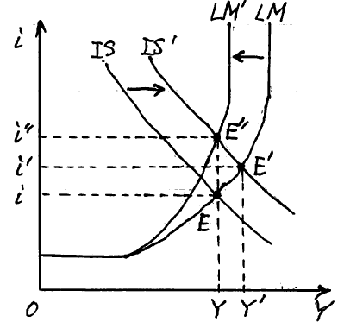
１０C．Under-employment and Monetary Policy 不完全雇用と金融政策
New Monetarists ⇒ When the economy retreats, the price P declines, real money balance M/P increases, Pigouvian effect works, and the LM curve shifts right from LM“ to LM ⇒ The second-round effect, ultimate effect, through a decline in the prices P, restores real income and real interest rate to the original level, equilibrium point E recovers, a decline in the money supply M lowers only the price P and does not affect the real economy, money is neutral, monetary policy is not effective due to the second-round effect.
Ultra Keynesian assumption that the price P is completely rigid in under-employment and Ultra monetarist 's assumption that the price P is perfectly flexible are not realistic. ⇒ Only empirical analysis can verify validity. Figures 16-14
ニューマネタリスト⇒景気が後退すると物価Pが下落、実質貨幣残高M/Pは増加、ピグウ効果が働いてLM曲線はLMからLMへと右方シフト。⇒二次的効果・究極的効果では
物価下落に伴って実質所得も実質利子率も元に戻り、均
衡点Eが回復。貨幣量Mの減少は物価Pのみを下落させ、
実体経済には影響しない、貨幣は中立、金融政策は効果
を持たない。
不完全雇用の状態では物価Pが完全に硬直的であるという
ウルトラ・ケインジアンの仮定も、物価Pが完全に伸縮的で
あるというウルトラ・マネタリストの仮定も、いずれも現実的
ではない、⇒実証分析によって検証 16-14図

Slide 33
１１．Under-employment and Fiscal Policy 不完全雇用と財政政策
(1) Active fiscal policy
Active fiscal policy increases aggregate demand by expanding fiscal expenditure G or reducing tax T in under-employment ⇒ In Figure 16-14, the IS curve shifts right from IS to IS ', equilibrium point shifts from E to E', the equilibrium interest rate shifts upward from i to i ', the equilibrium income also increases to shift from Y to Y '. Price P remains unchanged until full employment ... Keynesian first-round effect
New monetarist ⇒ Increase in real income Y reduces the degree of excess supply, the price P increases, decreases real money balance M / P,＝ second-round effect based on Pigouvian effect ⇒ the LM curve shifts to the left, equilibrium point shifts from E ‘to E “further, equilibrium interest rate rises to i”, equilibrium income decreases to Y”⇒ If price P is perfectly elastic Y“ returns to the original Y, ⇒ The effect of active fiscal policy is omnipotent. Figure 16-15
（１）積極財政政策
不完全雇用で財政支出Gの拡大か減税によって総需要を増やす積極財政政策
⇒16-14図でIS曲線はISからIS’へと右方シフト、均衡点はE点
からE’点にシフト、均衡利子率はiからi’へと上方へシフト、均衡
所得もYからY’へと増加。物価Pは完全雇用にいたるまでは不変
…ケインジアンの一次的効果
ニューマネタリスト⇒実質所得Yの増加により超過供給の度合
いが縮小し、物価Pが上昇、実質貨幣残高M/Pが減少、ピグウ
効果に基づく二次的効果⇒LM曲線は左方シフト、均衡点はE’
からさらにE”へと移り、均衡利子率がi”へ上がり、均衡所得はY”
へと減少⇒物価Pが完全に伸縮的であれば、Y”は元のYに戻り、
積極財政政策の効果は無力 16-15図

Slide 34
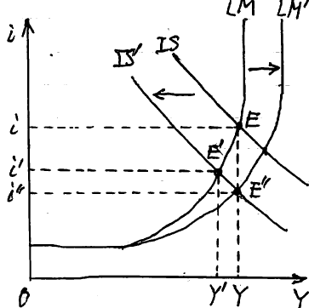
１１B．Under-employment and Fiscal Policy 不完全雇用と財政政策
(2) Fiscal Tightening Policy
Fiscal tightening policy reduces aggregate demand by decreasing fiscal expenditure G or increasing tax in under-employment
⇒ In Figure 16-16, the IS curve shifts left from IS to IS ‘. The equilibrium point shifts from point E to point E ’, the equilibrium interest rate shifts downward from i to i‘, and the equilibrium income also decreases from Y to Y ’. Price P is unchanged in the state of under-employment ... Keynesian first-round effect
New monetarist ⇒ Decrease in real income Y expands the degree of excess supply, price P declines, real money balance M / P increases,= second-round effect based on Pigouvian effect. ⇒ The LM curve shifts right and returns to its original position, the equilibrium point shifts further from E ‘to E “, the equilibrium interest rate decreases to i”, and the equilibrium income increases to Y “⇒ If price P is perfectly flexible, Y ”will return to the original Y, the effect of fiscal tightening policy will be omnipotent. Figure 16-16
（２）財政引き締め政策
不完全雇用で財政支出Gの減少か増税で総需要を減らす財政引き締め政策⇒16-16図でIS曲線はISからIS’へと左方シフト。均衡点はE点からE’点にシフト、均衡利子率はiからi’へと下方へシフト、均衡所得もYからY’へと減少。物価Pは不完全雇用の
状態では不変…ケインジアンの一次的効果
ニューマネタリスト⇒実質所得Yの減少により超過供給の度
合いが拡大し、物価Pが下落、実質貨幣残高M/Pが増加、
ピグウ効果に基づく二次的効果。⇒LM曲線は右方シフト
して元に戻る、均衡点はE’からさらにE”へと移り、均衡利子
率がi”へ下がり、均衡所得はY”へと増加⇒物価Pが完全に
伸縮的であれば、Y”は元のYに戻り、財政引き締め政策の
効果は無力 16-16図

